Slide 1
Chapter 4:
A Basic Collection Class
Data Structures in Java: From Abstract Data Types to the Java Collections Framework
by Simon Gray

Slide 2
Introduction
In this chapter we look at the Collection interface within the Java Collections Framework JCF)
Issues with inheritance, interfaces and abstract classes, iterators and Java generics are examined by building a simple BasicCollection class within the JCF
4-<number>

Slide 3
Java Collections Framework (JCF)
The JCF is a collection of interfaces, abstract and concrete classes providing a standard set of collection (container) types.
The Collection interface is root of much of the JCF interface inheritance hierarchy
Collection supports:
  required methods whose implementation provides the behavior described in the documentation. A concrete class implementing Collection must provide implementations for all the required methods. Note that none of the required methods modify a collection object. They are accessors, not mutators
  optional methods which need not be fully implemented by an implementing class. Instead, an optional method is given a default implementation consisting of a single line that throws an UnsupportedOperationException. The optional methods are all mutators
4-<number>

Slide 4
Collection<E> Required methods
boolean contains(Object target) | Returns true if this collection contains the target element.
boolean containsAll(Collection<?> c) | Returns true if this collection contains all of the elements in the collection c.
boolean isEmpty() | Returns true if this collection contains no elements.
int size() | Returns the number of elements stored in this collection.
Iterator<E> iterator() | Returns an iterator over the elements in this collection.
Object[] toArray() | Returns an array containing all of the elements in this collection.
<T> T[] toArray(T[] a) | Returns an array containing all of the elements in this collection with runtime type T.
4-<number>

Slide 5
Collection<E> Optional Methods
boolean add(E element) | Adds element to this collection. Returns true if the collection is modified.
boolean addAll(Collection<? extends E> c) | Adds all of the elements from the collection c to this collection. Returns true if the collection is modified.
boolean remove(Object element) | Removes a single instance of element from this collection, if it is present. Returns true if the collection is modified. This method relies on the equals() method defined in the runtime class of element.
boolean removeAll(Collection<?> c) | Removes all the elements found in the collection c from this collection. Returns true if the collection is modified.
boolean retainAll(Collection<?> c) | Retains only the elements in this collection that are also contained in the collection c. Returns true if the collection is modified.
void clear() | Removes all of the elements from this collection.
All optional methods not fully supported by an implementing class must throw an UnsupportedOperationException
4-<number>

Slide 6
BasicCollection Behavior
Allows duplicate elements – there can be two or more instances of the same element
Disallows null elements – trying to add a null element will generate an exception
Is non-positional – insertions and deletions are element-based; elements are inserted wherever is convenient
Has no fixed capacity – the collection can grow beyond the initial storage provided
Will provide implementations for
  all of the required methods from Collection
  the add() and remove() optional methods from Collection
4-<number>

Slide 7
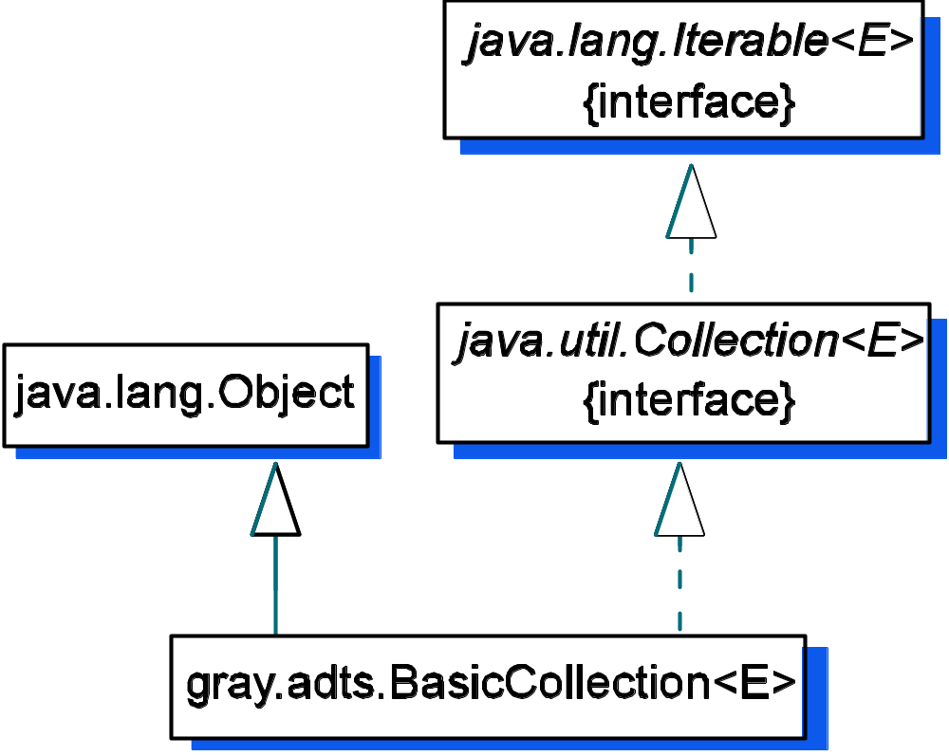
Inheritance Hierarchy for BasicCollection
extends
implements
4-<number>

Slide 8
The Iterator Software Design Pattern
Problem: The need to iterate over the elements in a collection and to do so in a fashion that is common across collection types
Solution: Provide an iterator interface that mandates how iterators will behave and have the collection object provide an “independent” iterator object that can iterate over the collection’s elements
4-<number>

Slide 9
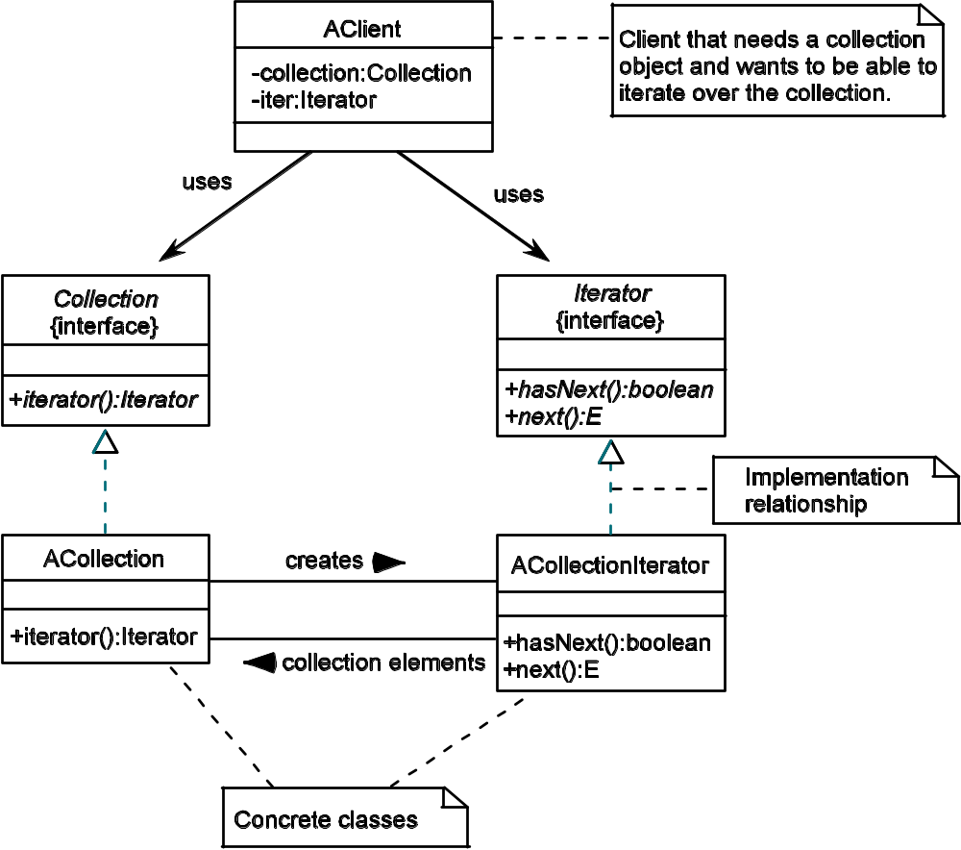
Structure of the Iterator Pattern
4-<number>

Slide 10
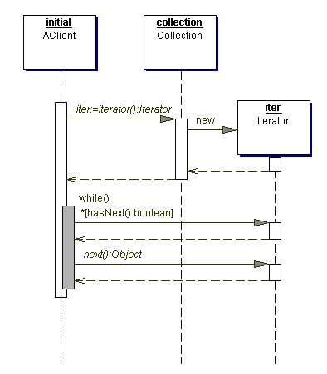
Iterator Behavior
1. client asks the collection
object for an iterator object
2. client uses the iterator object
to iterate through the elements
in the collection
There can be multiple iterators
simultaneously active on a collection
4-<number>

Slide 11
Java code…
Iterator iter = collection.iterator(); // create the iterator
while( iter.hasNext() ) //while there are more elements in the sequence
doSomething( iter.next() ); //do something with the next element
Consequences
  Element access independent of backing store.
  Specialized implementation for different traversals.
  Simultaneous iterations – more than one iterator on the same collection.
  Concurrent modifications – changes to the underlying collection during iteration.
4-<number>

Slide 12
Iterator<E> Interface
Required Methods
boolean hasNext() | Returns true if the iteration has more elements.
E next() | Returns the next element in the iteration.
Optional Methods All optional methods not fully supported by an implementing class must throw an UnsupportedOperationException.
void remove() | Removes from the underlying collection the element returned by the last call to next(). Once an element as been removed, remove() cannot be called again until another call to next() has been made.
4-<number>

Slide 13
Iterator Behavior
Method | Purpose | New Object State | Returned Value
Collection<String> c1 = new BasicCollection<String>() | Create an empty collection c1. | c1.size = 0 | a BasicCollection object for Strings
c1.add (“A”) | Add “A” to the collection c1. | c1.size = 1 “A” | true
c1.add(“B”) | Add “B” to the collection c1. | c1.size = 2 “A” “B” | true
c1.add(“C”) | Add “C” to the collection c1. | c1.size = 3 “A” “B” “C” | true
Iterator<String> iter = c1.iterator() | Get an iterator for collection c. | ▲ “A” “B” “C” | an iterator object
iter.hasNext() | Are there more elements in this iteration? |  | true
String s = iter.next() | Get next element in the iteration. | “A” ▲ “B” “C” | “A”
iter.hasNext() | Are there more elements in this iteration sequence? |  | true
s = iter.next() | Get next element in the iteration. | “A” “B” ▲ “C” | “B”
iter.remove() | Remove element returned by last call to next(). This changes the underlying collection object c1. | c1.size = 2 “A” ▲ “C”
iter.remove() | Try to remove another element. |  | InvalidStateException
iter.hasNext() | Are there more elements in this iteration sequence? |  | true
s = iter.next() | Get next element in the iteration. | “A” “C” ▲ | “C”
iter.hasNext() | Are there more elements in this iteration sequence? |  | false
cursor
4-<number>

Slide 14
BasicCollection Test Plan: Adding
How do you determine what should be in an oracle? Ask questions!
Example: How will add() affect the state of a BasicCollection object?
  size should increase by 1: verify with size()
  the collection can’t be empty: verify with isEmpty()
  added element should be in the collection: verify with contains()
4-<number>

Slide 15
Test Case 4.2: Adding to an Empty Collection
Method | Purpose | New Object State | Expected Result
Collection<String> c = new BasicCollection<String>() | Create an empty collection. | c.size = 0 | a BasicCollection object for Strings
c.add (“A”) | Add to the collection. | c.size = 1 “A” | true
c.add(“B”) | Add to the collection. | c.size = 2 “A” “B” | true
c.add(“C”) | Add to the collection. | c.size = 3 “A” “B” “C” | true
c.size() | Verify collection state. |  | 3
c.isEmpty() | Verify collection state. |  | false
c.contains(“A”) | Verify collection state. |  | true
c.contains(“B”) | Verify collection state. |  | true
c.contains(“C”) | Verify collection state. |  | true
c.contains(“Missing”) | Verify contains() operation. |  | false
4-<number>

Slide 16
BasicCollection Test Plan: Removing
How will remove() affect the state of a BasicCollection object?
  remove() should return true if the element was in the collection
  size should decrease by 1: verify with size()
  contains(element) should return false (assuming the element didn’t have a duplicate in the collection -> be clear about testing conditions!)
4-<number>

Slide 17
Test Case 4.3: Removing from a Collection
Method | Purpose | New Object State | Expected Result
Collection<String> c = new BasicCollection<String>() | Create an empty collection. | c.size = 0 | a BasicCollection object for Strings
c.add (“A”) | Add to the collection. | c.size = 1 “A” | true
c.add(“B”) | Add to the collection. | c.size = 2 “A” “B” | true
c.add(“C”) | Add to the collection. | c.size = 3 “A” “B” “C” | true
c.remove(“B”) | Test remove op. | c.size = 2 “A” “C” | true
c.size() | Verify collection state. |  | 2
c.contains(“B”) | Verify collection state. |  | false
c.isEmpty() | Verify collection state. |  | false
4-<number>

Slide 18
Java Generics: Printing a Collection
Goal: Create a method to print all the elements in a collection.
Problem: How to express the type in the parameter list?
10 // This method is specific to a collection of Shape objects.
11 // Note the variable type in the for loop.
12 static void printShapeCollection( Collection<Shape> collection ){
13 for ( Shape shape : collection )
14 System.out.println( shape );
15 }
. . .
26 Collection<Shape> shapes = new BasicCollection<Shape>();
27 shapes.add( new Circle( 5.0 ) );
28 shapes.add( new Rectangle( 4.5, 21.2 ) );
29 shapes.add( new Cube( ) );
30 System.out.printf( “From printShapeCollection( shapes )\n”);
31 printShapeCollection( shapes );
32
33 Collection<Circle> circles = new BasicCollection<Circle>();
34 circles.add( new Circle( 5.0 ) );
35 circles.add( new Circle( 15.0 ) );
36 circles.add( new Circle( 25.0 ) );
37 //printShapeCollection( circles ); // ERROR!
Lesson: While a Circle “is a kind of” Shape, a
Collection<Circle> is NOT “a kind of” Collection<Shape>!
Think of it this way. If Collection<Circle> “is a kind of”
Collection<Shape>, then anything you can do to
Collection<Shape>, you should be able to also do to
Collection<Circle>, but I can add a Rectangle to
Collection<Shape>, but not to Collection<Circle>!
Collection<gray.adts.shapes.Shape>) in
UnboundedWildcardEx cannot be applied to
(java.util.Collection<gray.adts.shapes.Circle>)
4-<number>

Slide 19
The Unbounded Wildcard ‘?’
So, what to do? We need more flexibility in the type parameter.
That is, instead of specifying the exact type of the collection, we
want to accept a collection storing a family of types. Java’s
solution is the type wildcard, ?, which, because it matches
anything, is called an unbounded wildcard. More formally,
? is said to be an “unknown type”; thus Collection<?> is a
“collection of unknown type.”
18 // The most general print method. It will print collections of
19 // any kind of type. Note the variable type in the for loop.
20 static void printAnyCollection( Collection<?> collection ){
21 for ( Object element : collection )
22 System.out.println( element );
23 }
4-<number>

Slide 20
Another Example: Collection.containsAll()
Note that the element type of the Collection c must
match the element type of the Iterator over c.
1 public boolean containsAll( Collection<?> c ) {
2 Iterator<?> e = c.iterator();
3 while ( e.hasNext() )
4 // does this collection contain the
5 // next element from c?
6 if( !contains( e.next() ) )
7 // nope, c has an element we don’t have
8 return false;
9 return true; // yep, we have all the elements c has
10 }
4-<number>

Slide 21
Bounded Wildcards
There will be times when we don’t want the broad inclusiveness of the unbounded wildcard and would prefer to put a bound on the family of types accepted. The bounded wildcard does this.
Example: The addAll() method from Collection.
Here is the class header for AbstractCollection
public abstract class AbstractCollection<E>
implements Collection<E> {
This means we can store elements of type E or any of E’s subclasses
in the collection.
4-<number>

Slide 22
Bounded Wildcard
public abstract class AbstractCollection<E>
implements Collection<E> {
What should be the parameter for addAll()?
1st attempt
public Boolean addAll(Collection<E> c)
Too restrictive. This would preclude adding a
Collection<Circle> to a Collection<Shape> or
a Collection<Integer> to a Collection<Number>.
2nd attempt
public Boolean addAll(Collection<?> c)
Not restrictive enough. Would let you try to add a Collection<Shape> to a Collection<Number>.
4-<number>

Slide 23
Bounded Wildcard: <? extends E>
What we need is a flexible mechanism that will allow us to specify
a family of types constrained by some “upper bound” on the type
family. Java’s bounded wildcard does just this.
1 // method from AbstractCollection<E>
2 public boolean addAll(Collection<? extends E> c) {
3 boolean modified = false;
4 Iterator<? extends E> e = c.iterator();
5
6 while ( e.hasNext() ) {
7 if ( add( e.next() ) )
8 modified = true;
9 }
10 return modified;
11 }
The bounded wildcard in the parameter type means that the
Collection type is unknown, but is bounded by type E. That
is, the element type of c must be E or one of its subclasses.
4-<number>

Slide 24
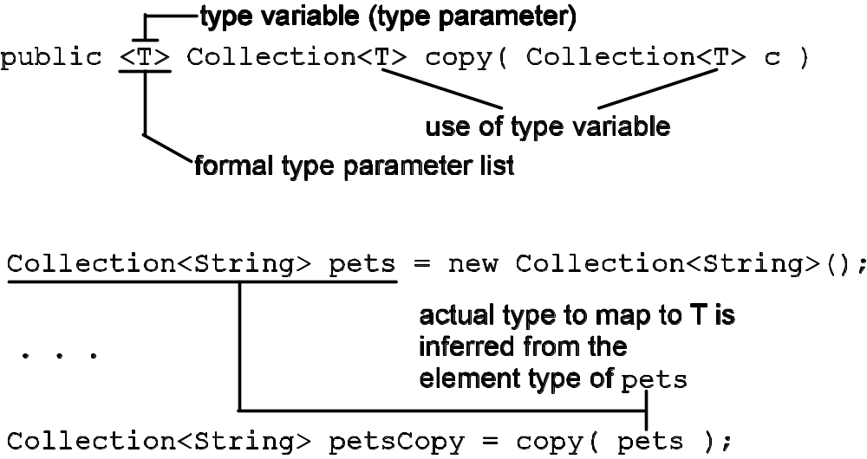
Generic Methods
Just as classes can be generic, so can methods
Declaration
Application
4-<number>

Slide 25
Generic Methods: Two Examples
18 <T> Collection<T> reverseCopy( Iterator<T> source ) {
19 LinkedList<T> theCopy = new LinkedList<T>();
20 while ( source.hasNext() )
21 theCopy.addFirst( source.next() ); // add at front of list
22 return theCopy;
23 }
24
25 <E> Collection<E> reverseCopy( Collection<E> source ) {
26 LinkedList<E> theCopy = new LinkedList<E>();
27 for ( E element : source )
28 theCopy.addFirst( element ); // add at front of list
29 return theCopy;
30 }
33 Collection<String> pets = new BasicCollection<String>();
40 Collection<String> petsCopy = copy( pets );
45 petsCopy = reverseCopy( pets );
50 petsCopy = reverseCopy( petsCopy.iterator() );
4-<number>

Slide 26
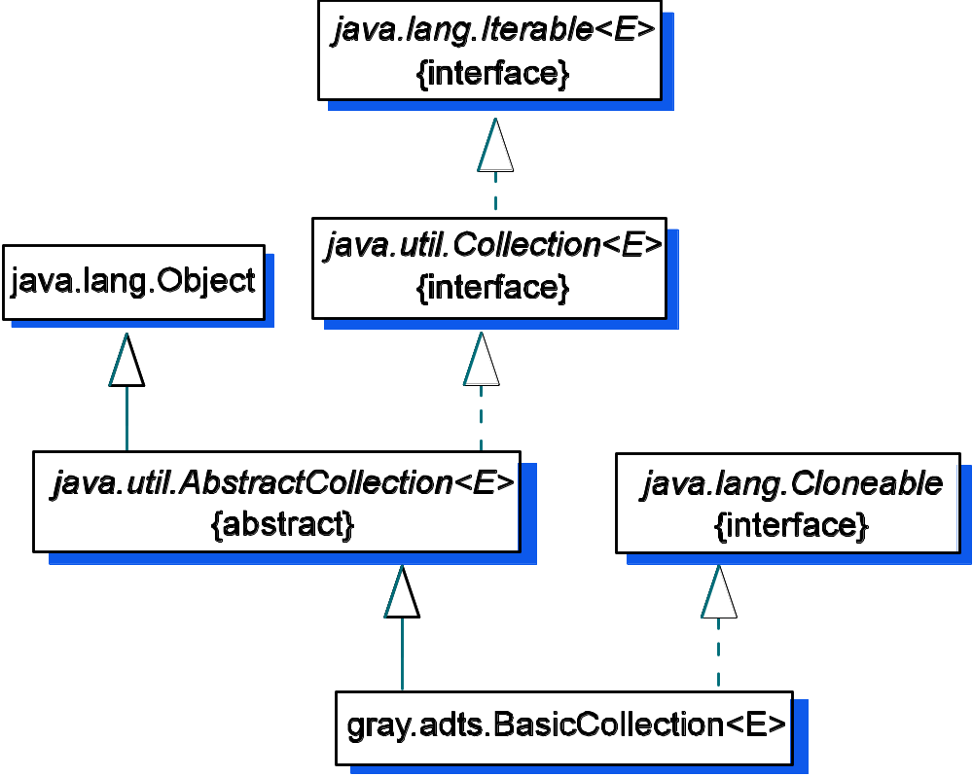
Building Within the JCF
Abstract classes
are building blocks:
they provide partial
implementations
of interfaces
4-<number>

Slide 27
AbstractCollection<E>
Allow methods within the abstract class to make use of other methods in the abstract class, even if those methods haven’t been implemented yet!
public boolean isEmpty() {
return size() == 0;
}
contains() uses Iterator methods
without knowing how they are
implemented -> abstraction!
1 public boolean contains( Object o ) {
2 Iterator<E> e = this.iterator(); // get an iterator for this collection
3 // if o is null, it would be catastrophic to try to do o.equals()
4 if ( o == null ) {
5 while ( e.hasNext() ) // look for the first null entry
6 if ( e.next() == null )
7 return true; // success: o was found
8 } else { // o is an object & implements equals()
9 while ( e.hasNext() )
10 if ( o.equals( e.next() ) )
11 return true; // success: o was found
12 }
13 return false; // failure: o wasn’t found
14 }
4-<number>

Slide 28
Implementing BasicCollection
Have a plan! Identify the things that have to be done
⇒ create a list of tasks
Define attributes, including deciding on the backing store for the collection’s elements
Provide implementations for the methods left abstract in AbstractCollection<E>: size() and iterator()
Define BasicIterator<E> that implements the Iterator<E> interface
Provide overridden implementations for the optional methods add() and remove()
4-<number>

Slide 29
Task 1: class header and attributes
What kind of structure should we use to store the elements?
  array
  linked list
Note: you need to use the same
type variable for the class, the
superclass, and the array
element type
public class BasicCollection<E>
extends java.util.AbstractCollection<E> {
// BasicCollection data fields
private E[] collection;
private int size;
4-<number>

Slide 30
Task 2: Identify methods to implement
What can we inherit from AbstractCollection?
What abstract methods must be implemented? What must be overridden?
Collection Methods | Implementing Classes
 | AbstractCollection<E> | BasicCollection<E>
boolean contains(Object) | concrete | inherited
boolean containsAll(Collection<?> c) | concrete | inherited
boolean isEmpty() | concrete | inherited
Object[] toArray() | concrete | inherited
<T> T[] toArray(T[] a) | concrete | inherited
int size() | abstract | implement
Iterator<E> iterator() | abstract | implement
boolean add(E o) | optional | overridden
boolean addAll(Collection<? extends E> c) | optional | inherited
boolean remove(Object o) | optional | overridden
boolean removeAll(Collection<?> c) | optional | inherited
boolean retainAll(Collection<?> c) | optional | inherited
void clear() | optional | inherited
4-<number>

Slide 31
Implementing methods
size() just returns the size data field
iterator() just instantiates and returns an instance of BasicIterator
The add() and remove() methods inherited from AbstractCollection throw an UnsupportedOperationException; we’ll need to fix that, but first…
4-<number>

Slide 32
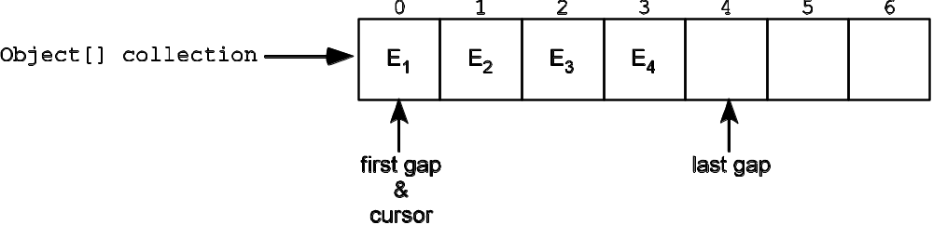
Define BasicIterator<E>
To have access to the collection’s elements, the iterator needs to have internal knowledge of the collection’s implementation
  ⇒ make BasicIterator an inner class
Map the logical model of an iterator to the structure storing the collection’s elements
size = 4
Logical Model | Implementation
first gap | array index 0
last gap | array index size
cursor | 0 ≤ cursor ≤ size
cursor stores the index of the
element to be returned by next()
4-<number>

Slide 33
Iterator: Concurrent modifications
What happens if the collection is modified while an iteration is in progress?
This problem is called concurrent modification and occurs when the collection is structurally modified through the collection object while an iteration is in progress. Some scenarios:
  An element is added to the collection and is placed before cursor’s position in the current iteration sequence, so will be missed by the iterator
  The last element of the iteration sequence is removed so that cursor is now in the last gap, perhaps confusing hasNext()
  ⇒ throw a ConcurrentModificationException
4-<number>

Slide 34
Concurrent modification: Two problems
Problem 1: Detecting concurrent modification
Solution: add a modcount variable to BasicCollection to keep track of structural modifications (adds/deletes)
  modcount is incremented each time the collection object is structurally modified via an add or remove operation from Collection
  When a BasicIterator object is created, it copies the collection’s modCount variable into a local variable, expectedModCount
  The iterator methods check for concurrent modification by seeing if expectedModCount is equal to modCount. If there have been no structural changes to the collection, the two count variables will be equal, otherwise an exception is thrown
4-<number>

Slide 35
Concurrent modification: Two problems
Problem 2: Iterator.remove() has two stipulations
  the element to remove is the last element returned by next()
  Iterator.remove() can only be called once per call to next() (since next() supplies the element to remove)
Solution: We can handle this with a flag okToRemove in the BasicIterator class that is
  initialized to false
  set to true by next(); set to false by Iterator.remove(). This will guarantee that each call to remove() will be paired with a call to next()
4-<number>

Slide 36
Dealing with Concurrent Modification
operation | BasicCollection modCount | BasicIterator expectedModCount | BasicIterator okToRemove
Collection<String> c = new BasicCollection<String>() | 0 | - | -
c.add(“A”) | 1 | - | -
c.add(“B”) | 2 | - | -
Iterator<String> iter = c.iterator() | 2 | 2 | false
iter.next() | 2 | 2 | true
iter.remove() | 3 | 3 | false
c.remove() | 4 | 3 | false
iter.next() | ConcurrentModificationException
4-<number>

Slide 37
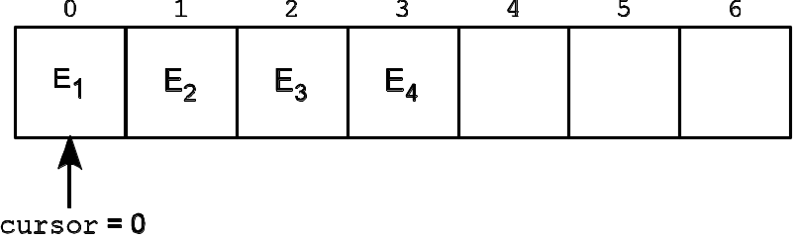
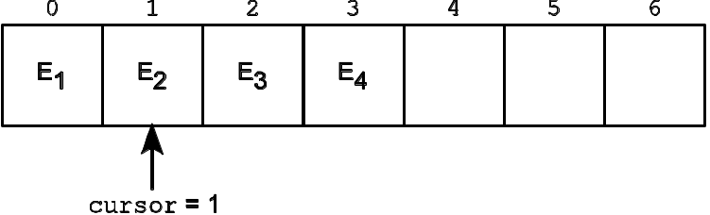
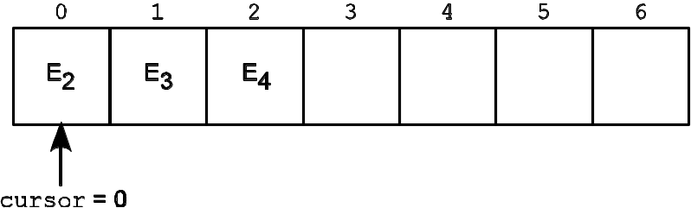
BasicIterator.remove(): updating cursor
Recall, cursor is the index of the element to return by next(). Need to be careful about updating cursor
Iterator iter = c.iterator();
Object o = iter.next(); // gets E1
Remove E₁, shift all the other
elements down a position
iter.remove(); // removes E1
Decrement cursor so it
indexes the correct element
4-<number>

Slide 38
Task 4: Implement add() and remove()
public boolean add( E element ) {
if ( element == null )
throw new java.lang.IllegalArgumentException();
// if the collection is at capacity, make it bigger by 50%
if ( this.size == collection.length )
resize(this.size + this.size / 2 );
collection[size] = element;
size++;
modCount++; // collection has been structurally modified;
// need to keep track of each modification
return true;
}
4-<number>

Slide 39
Task 4: Implement add() and remove()
public boolean remove( Object element ) {
if ( element == null ) {
throw new IllegalArgumentException();
}
int p = find( element );
if ( p == -1 ) {
return false;
}
for ( int i = p; i < size - 1; i++ ) {
collection[i] = collection[i + 1];
}
collection[size - 1] = null; // clean up after ourselves
size--;
modCount++; // collection has been structurally modified;
// need to keep track of each modification
return true;
}
4-<number>

Slide 40
Iterator.remove(): use Collection.remove()
public void remove() { // THIS IS THE BASICITERATOR.REMOVE() METHOD
// check for concurrent modification
if ( expectedModcount != modCount ) {
throw
new java.util.ConcurrentModificationException();
}
// check that there has been a next() message to
// provide an element to remove
if ( !okToRemove ) {
throw new IllegalStateException();
}
okToRemove = false;
// Use BasicCollection's remove() method to do the actual removal. Need
// to predecrement cursor to get to the LAST element returned by next().
// After the removal, this will be the value cursor should have for the
// next call to next().
--cursor;
BasicCollection.this.remove( collection[cursor] );
// increment expectedModcount since the remove() message above to the
// collection object will have incremented modCount
expectedModcount++;
}
4-<number>

Slide 41
Analysis of the Implementation
The cost of the operations in BasicCollection is determined by our understanding of
  the cost of the basic array operations
  the implementation details of BasicCollection’s methods
Method | Cost
add() | Ο(1)
remove() | Ο(n)
contains() | Ο(n)
size() | Ο(1)
isEmpty() | Ο(1)
4-<number>

